Slide 1
The Manufacturer’s Guide to Logistics Solutions
Replenishment systems that bring peace of mind

Slide 2
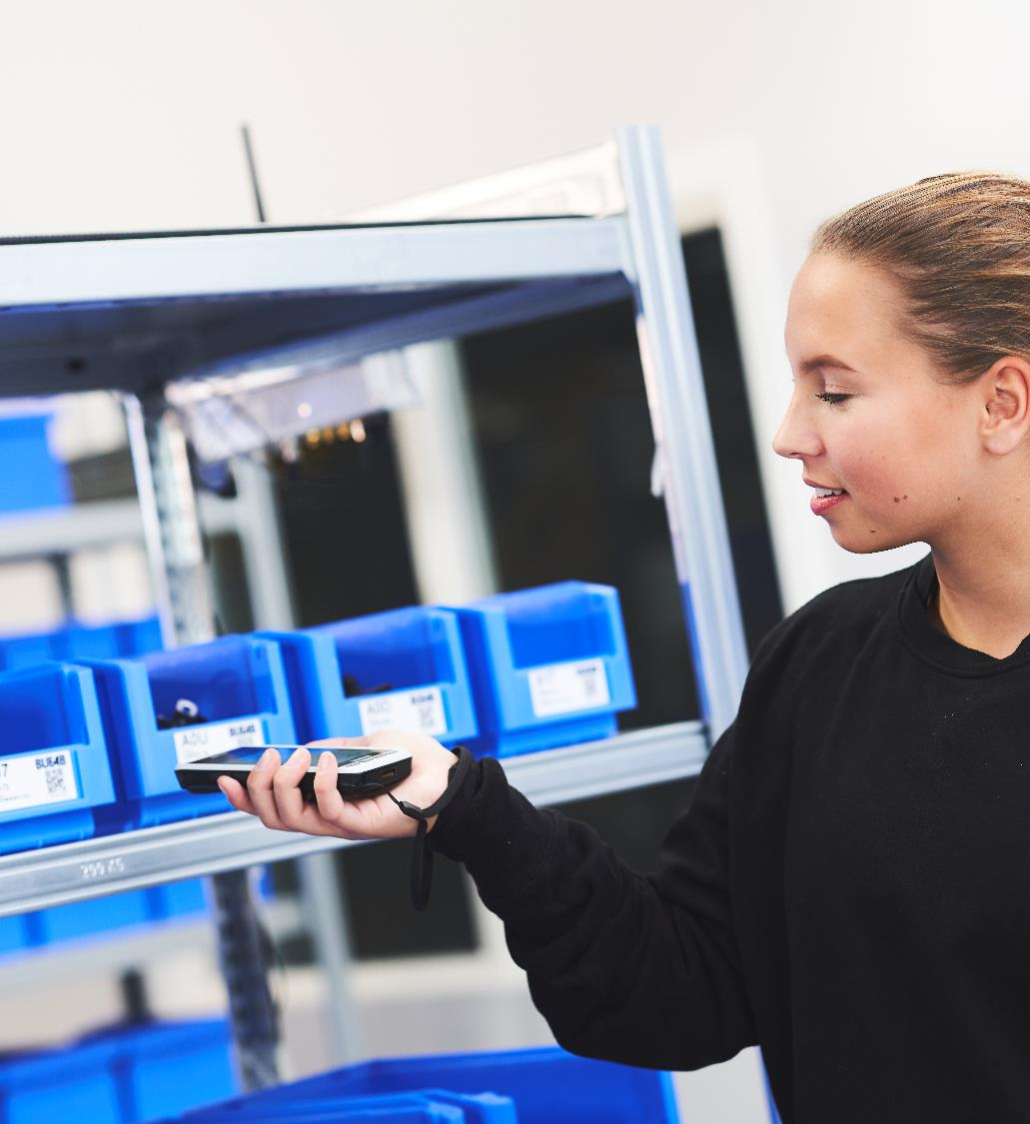
In this guide
Why invest in a logistics solution?
3
What options do you have?
4
Barcode scanners
5
RFID solutions
7
Scale solutions
11
E-labels
13
Vending machines
15
Combining different logistics solutions
17
System software
18
Get in touch
19

Slide 3
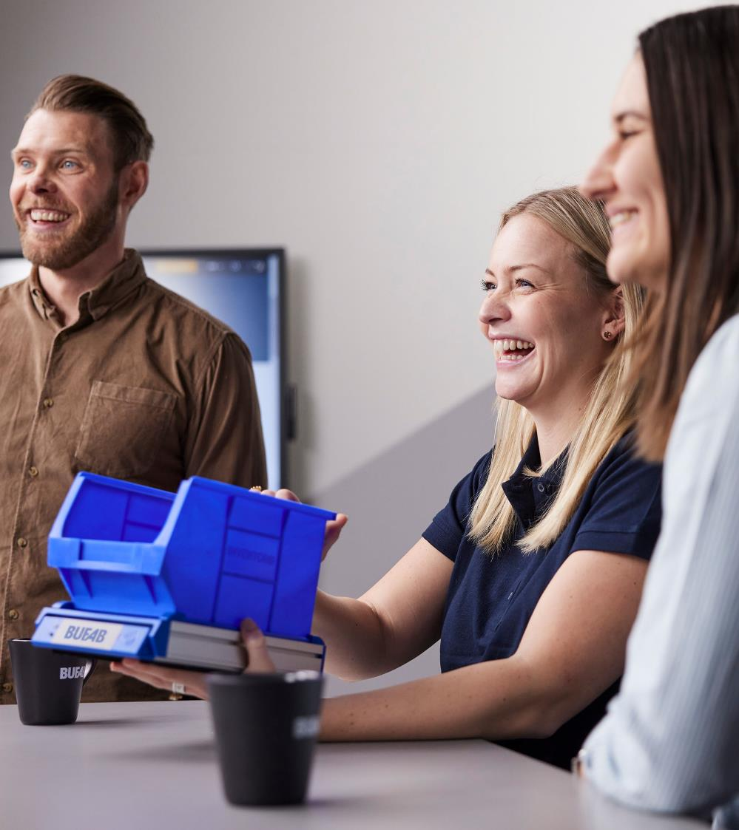
Why invest in a logistics solution?
All logistics solutions have the same basic purpose – giving you reliable access to the C-parts you need at the right time, at the lowest possible total cost, and with as little manual work as possible.
Traditionally, manufacturers relied on manual stock counts and orders to replenish their C-parts inventories. Logistics solutions, often called vendor-managed inventory (VMI) solutions, eliminate these processes by automating stock-keeping and reordering. Although some logistics solutions require a complex setup, the main benefits they provide are:
Reducing or eliminating manual processes, both for production staff and purchasers who would otherwise have to monitor stock levels and place replenishment orders themselves.
Minimizing the risk of stockouts by enabling automatic ordering once stock levels fall below a pre-determined point.
Saving space by getting rid of the need to keep large quantities of C-parts in stock – instead, new parts can easily be ordered only when they’re needed.

Slide 4
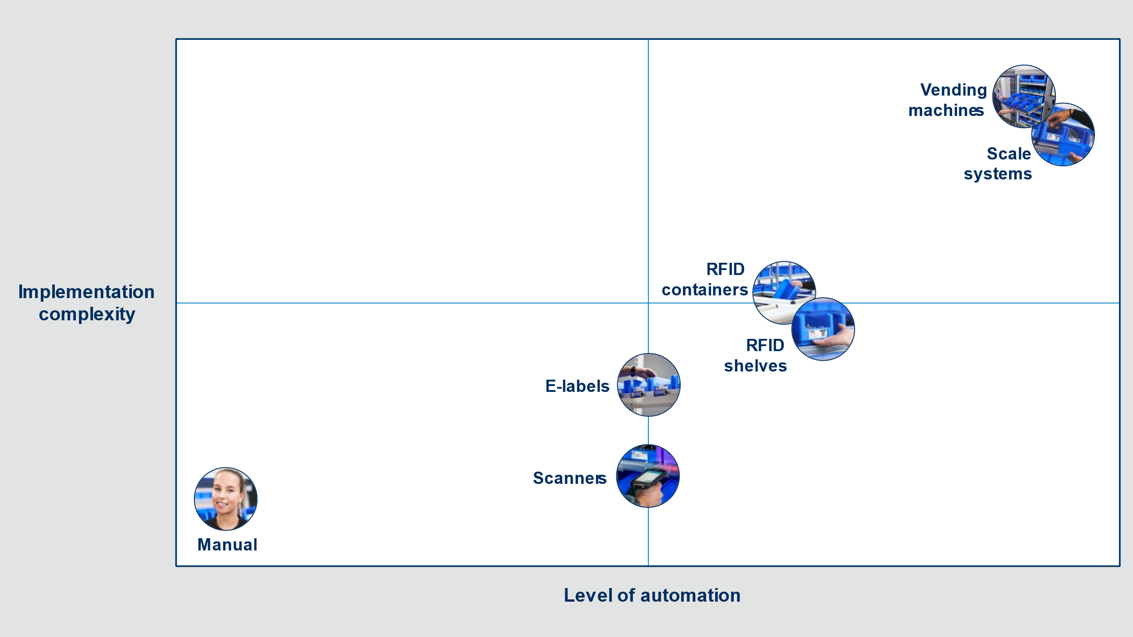
What options do you have?
In the following few slides, we’ll go through some of the leading systems types currently available, explain the benefits and drawbacks of each one, and give some suggestions on how they can be combined to add the most value to your operations.
Logistics Solutions can generally be compared on how complex they are to implement and the level of automation they provide. Systems that offer a high level of automation are typically more complex to implement.
At the end of the day, the best approach when investing in a logistics solution is to work with your supplier to find the most appropriate solution for your C-parts operation or combine them to achieve an optimized and cost-effective effect.

Slide 5
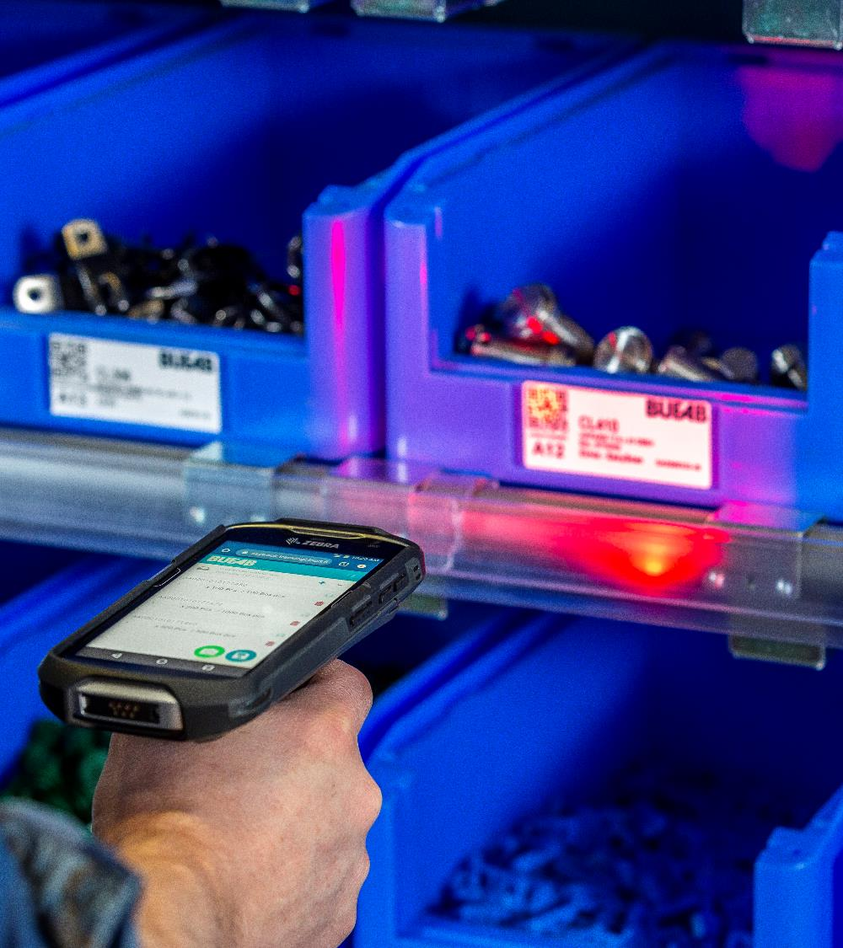
Barcode scanner systems
They are one of the easiest logistics solutions to set up. Each C-part is typically divided into dual bins placed on shelves. When a bin is empty, the barcode is scanned with a handheld scanner or smartphone and placed behind the second bin, which is now brought to the front of the shelf. The inventory system is then updated, and an order can be made manually by staff or automatically by the C-parts supplier. Ensure that you have access to a system with order information.
Benefits
Easy setup – bins and a scanner are all that is needed.
Simple operation for the user.
Potential drawbacks
Scanning is a manual process – so it’s possible for empty bins to go unscanned due to human error.
Discipline is required in the workforce to make sure empty bins are scanned.

Slide 6
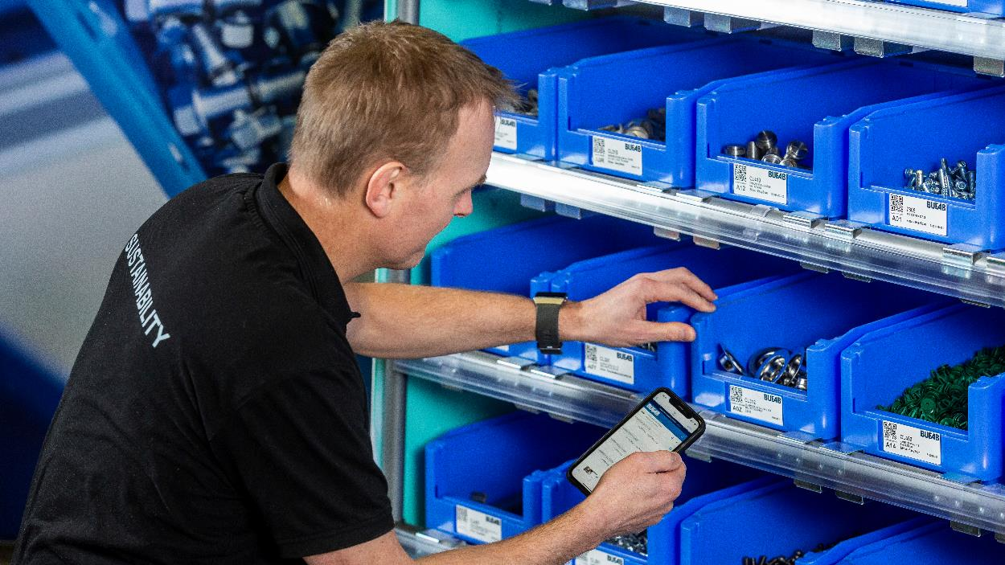
Barcode scanners
Ideal application
A manufacturing facility where an easy-to-use, quick-to-implement solution is needed to reduce the level of manual work in stock keeping and replenishment.
Level of automation
This solution has a low level of automation – bins need to be manually scanned every time they are emptied. However, the setup is relatively simple and low-cost.
Explore this solution on bufab.com

Slide 7
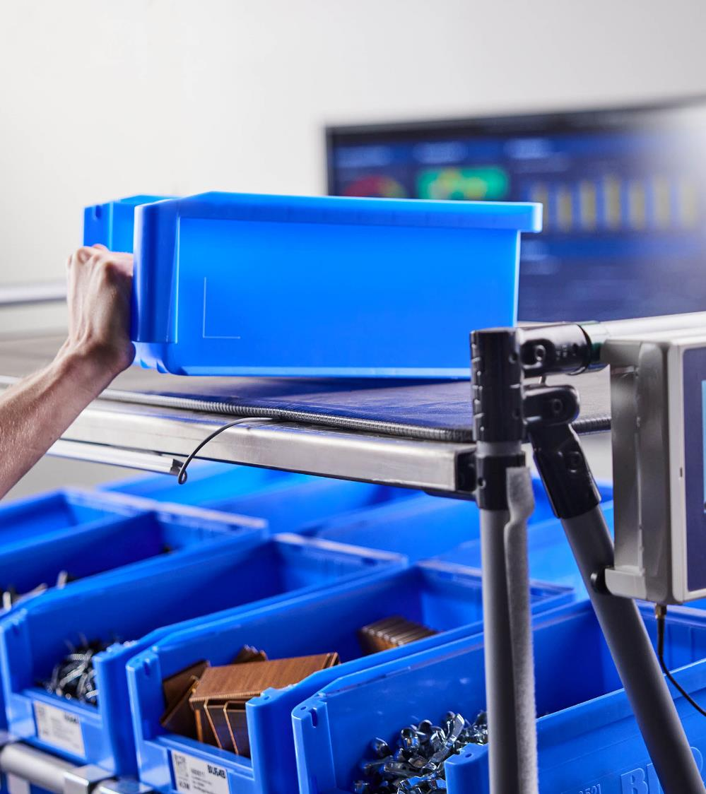
RFID shelf systems
In these systems, bins are fitted with RFID tags, and the upper shelves with sensors. When a bin is empty, the operator places it on the upper shelf. The sensor detects the empty bin, and in the same way as with the barcode scanner system, the inventory system is updated and an order is placed.
Benefits
Operation is simple – workers don’t need any extra equipment to use the system properly.
All production staff can use it – there’s no need to nominate one person to be responsible for moving bins, as with the barcode scanner systems.
Potential drawbacks
Some manual intervention is still needed – if empty bins aren’t moved to the upper shelf, the inventory system won’t be updated, and no order will be placed.
There is a higher cost associated with this setup than with a barcode scanner solution.

Slide 8
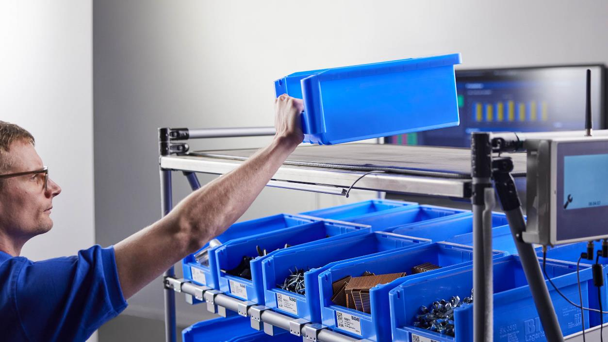
RFID shelf systems
Ideal application
A fast-moving manufacturing environment that needs an automated replenishment solution that doesn’t create any extra routines for production staff.
Level of automation
The level of automation with the RFID shelf system is higher compared to the barcode scanner, since the simple action of placing an empty box on the top shelf is enough to trigger an update. Because of the RFID-sensing mats, the implementation of this system is slightly more complex and costly, and not as flexible as a scanner solution.
Explore this solution on bufab.com

Slide 9
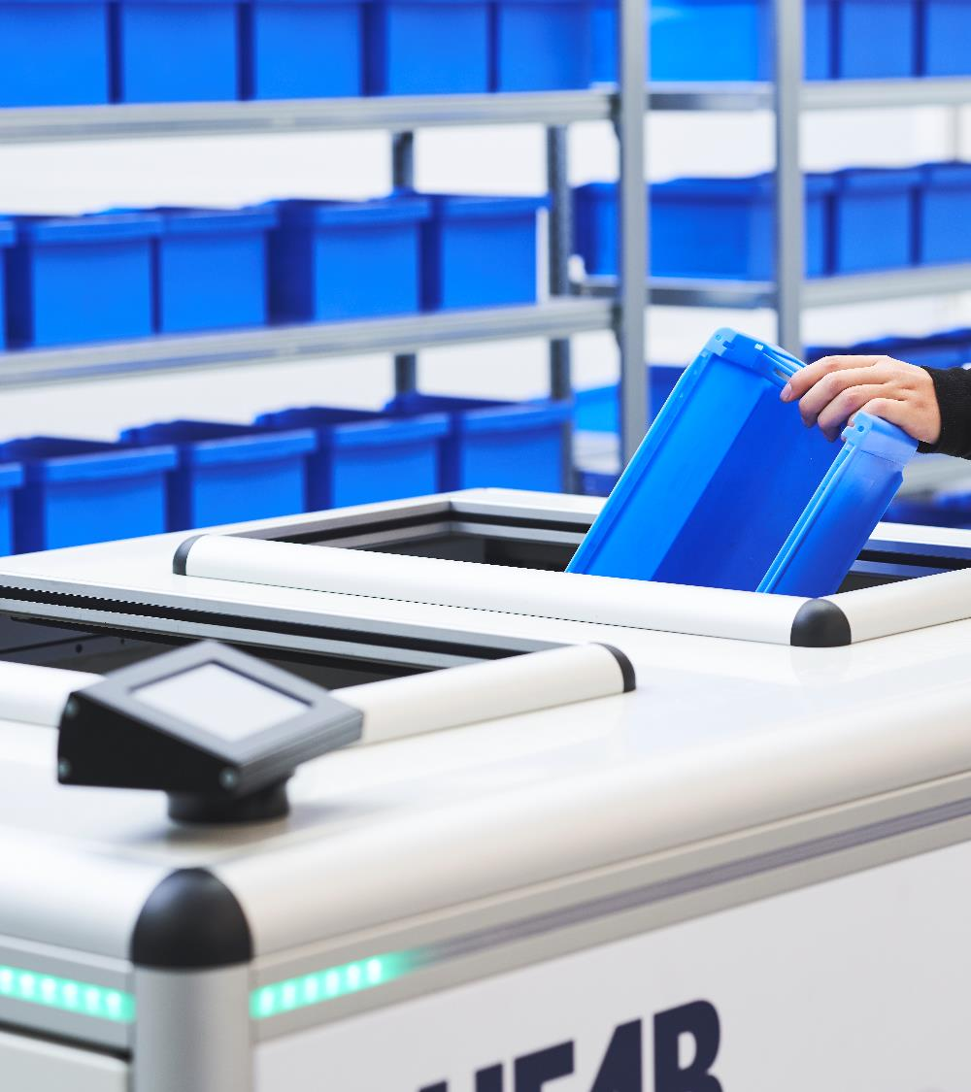
RFID container systems
These systems work on the same principle as the RFID shelf system. However, when a C-parts bin is emptied, it is placed in a central container rather than on the shelf above. A sensor inside the container detects the empty bin, the system is updated, and an order is placed.
Benefits
All empty bins are gathered in the same place – making this solution well-suited to environments with tens or hundreds of C-parts bins.
Drawbacks
The containers need more space than a scanner.
The container or containers must be placed close to the bin racks to be really valued by the operators.

Slide 10
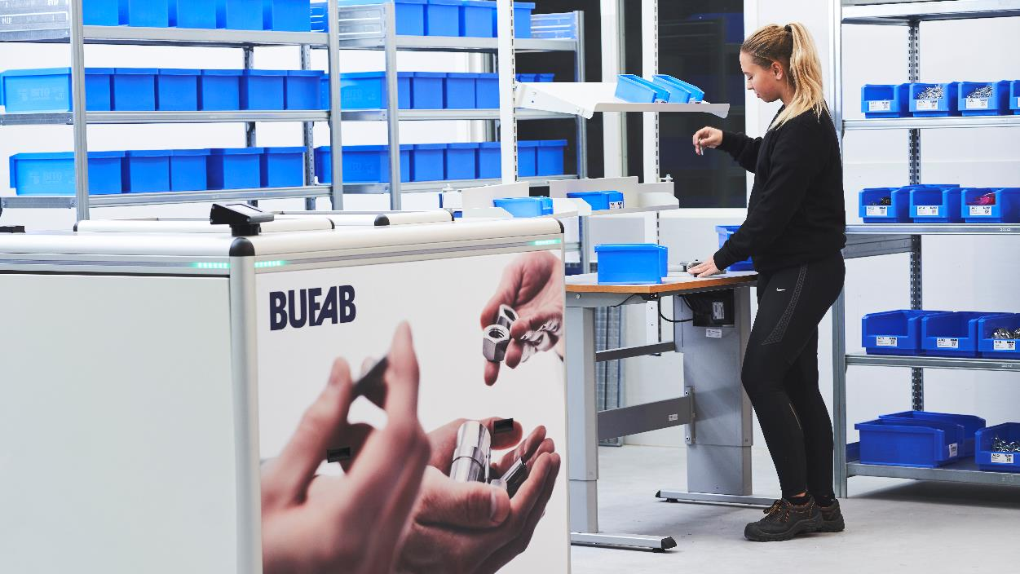
RFID container systems
Ideal application
A spare parts supermarket where many different components are stored on shelves close to each other. Adding empty top shelves to place empty bins on can be considered a waste of space, but since one container can serve many racks, it can be an optimal solution. Easy to use and reduces clutter.
Level of automation
For this system, the level of automation is practically the same as with the RFID shelf system. However, the system needs a larger volume of bins than the shelf system to be the most economical choice.
Explore this solution on bufab.com

Slide 11
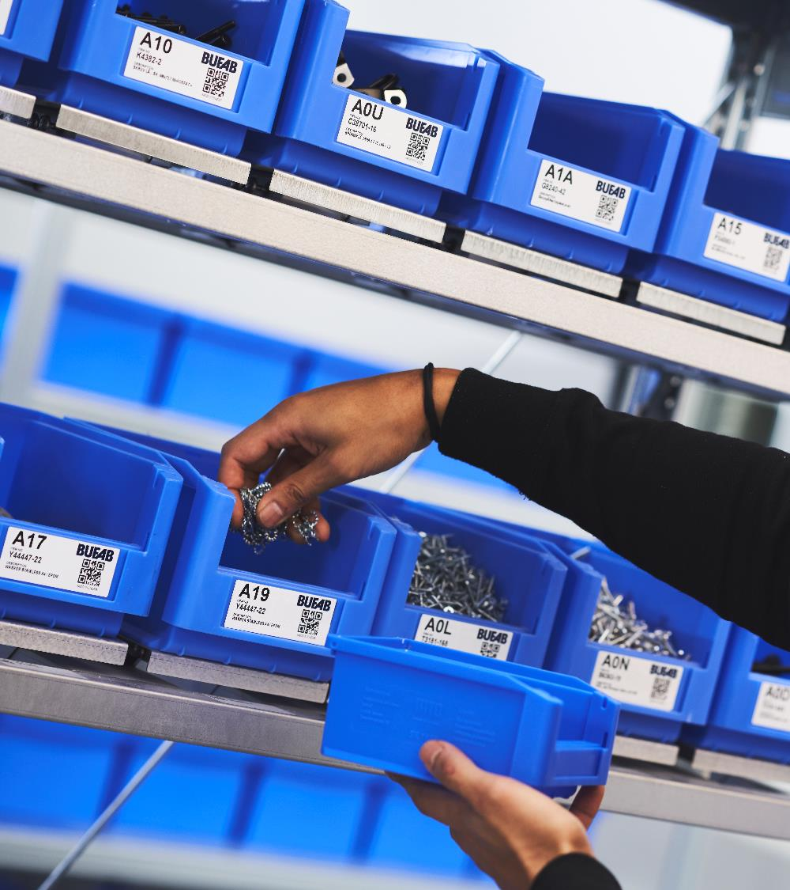
Scale systems
In these systems, each C-parts bin is placed on a scale that constantly monitors the bin’s weight. The scales can be fitted on shelves or mounted directly on the bin, creating a mobile unit. When parts are taken from the bin, the total weight is reduced, and the system is continuously updated with the exact number of parts available.
Benefits
When installed, no manual intervention is required. An operator only needs to take the parts for the stock level to automatically update.
Most other solutions only update the inventory system when a bin is emptied. With a scale solution, data on the exact number of available parts is always accurate in real time.
Mobile scale units create flexibility and are also suitable for placement at the point of use. Scale systems are also available for high runners on pallets instead of bins.
Potential drawbacks
Because each bin requires its own individual scale, a system like this comes with a higher investment, especially when used in multiple locations in the production facility or with many different parts.

Slide 12
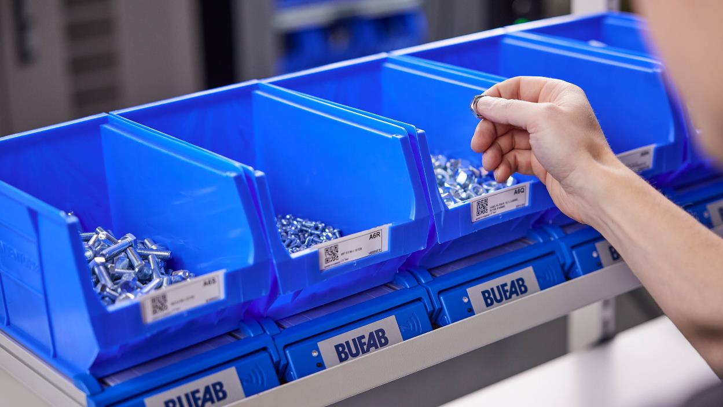
Scale systems
Ideal application
Any manufacturing operation that uses fast-moving, highly critical C-parts that must never run out.
Level of automation
A scale system offers the highest level of automation compared to the other systems shown here. No manual input apart from taking C-parts from the bin is needed to update the inventory system, and the real-time data this solution provides creates further possibilities for more automation.
The mobile units provide unparalleled flexibility.
Explore these solutions on bufab.com

Slide 13
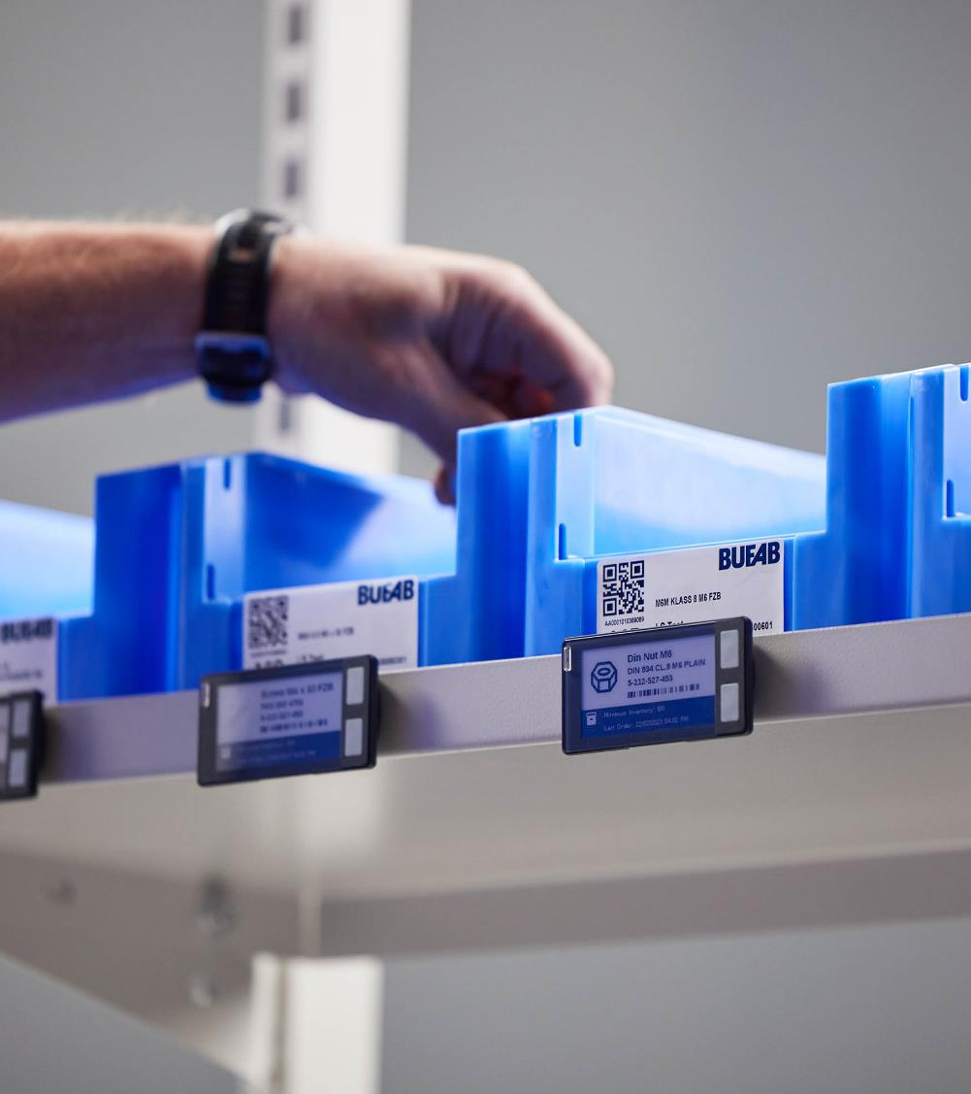
E-labels
The innovative e-label makes it easy to label and update bins and shelves quickly with item information and an image. It is also possible to get automatic updates with order information. Depending on user preferences, the e-labels can be placed on the shelf or directly on the bin.
Benefits
Operators can create orders directly from the label, saving valuable time and reducing errors.
The label can display the real-time order status.
It becomes easier to find and verify the product with pictures.
It is easy to make updates without the need to print labels.
Potential drawbacks
The battery needs to be changed every 5 years.
Not as sustainable as a printed label, but that may be compensated for with upsides like fewer transports and less waste.
The human factor can make it possible to misplace a box, resulting in the operator picking the wrong item if the e-label is not attached directly to the box.

Slide 14
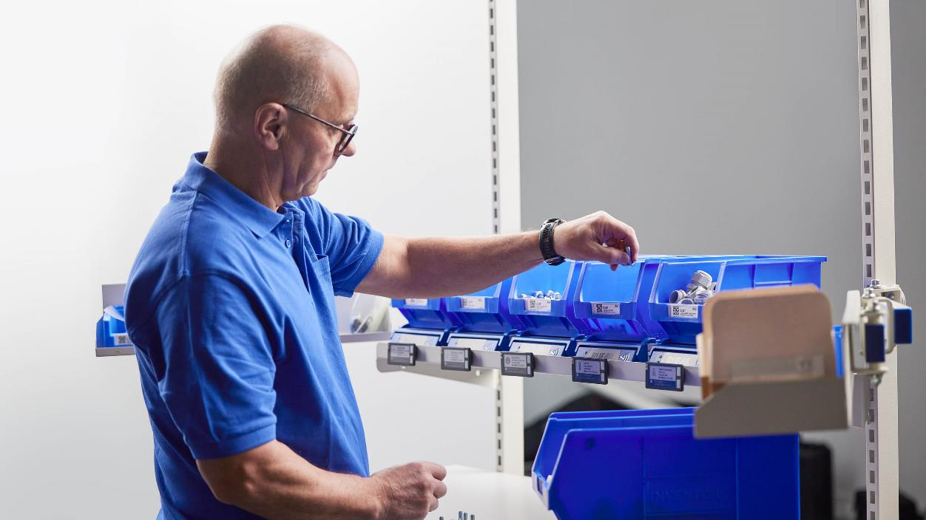
E-labels
Ideal application
Ideal for supermarkets, production lines, and other areas where accurate and efficient inventory management is crucial. Placed on a mobile unit with a scale, it will provide an easy and secure replenishment.
Level of automation
The level of automation is quite similar to scanners. The operator presses the button and an order is placed.
Explore this solution on bufab.com

Slide 15
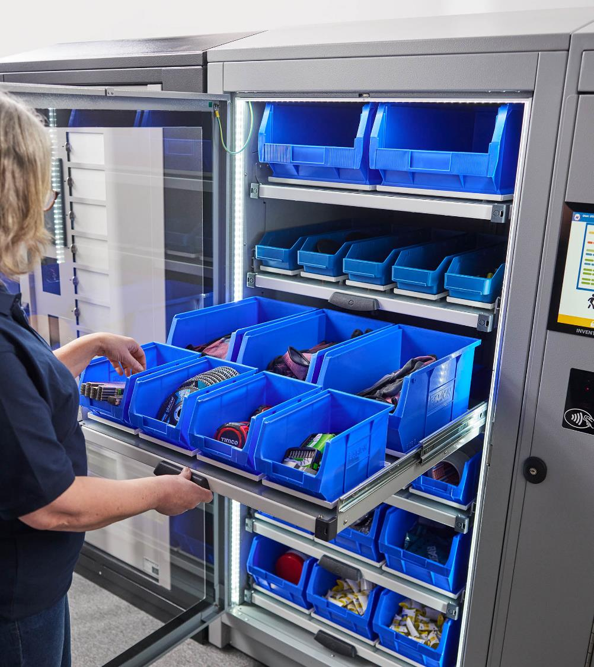
Vending machine systems
These systems are well-suited to storing and distributing MRO (Maintenance, Repair, and Operations) and PPE (Personal Protective Equipment) articles. Operators get quick product access to the items they need without manual registration, boosting production efficiency. Specialized units are also available for lending out expensive or shareable equipment to authorized users.
Benefits
Real-time individual withdrawal through an access control system increases responsibility and reduces the risk of overconsumption. As a result, companies typically save up to 30% on their MRO and PPE spending while ensuring that the right equipment is always available.
Weight sensor technology provides user-friendly product access and an easy way to refill and monitor stock levels, allowing for better cost control and inventory management.

Slide 16
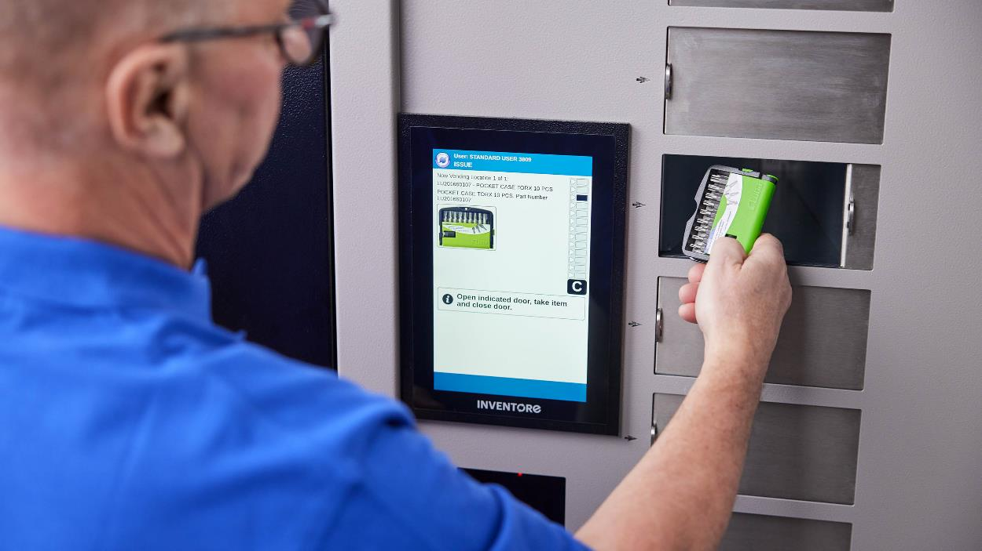
Vending machine systems
Ideal application
Operations that want to increase control and reduce spending on PPE and MRO articles while providing all users efficient accessibility.
Level of automation
The vending machines provide a high level of automation. The user must identify and select the item. The system manages the ordering as needed by set parameters, but manual work is needed to feed the unit with the new products.
Explore these solutions on bufab.com

Slide 17
Combining logistics solutions
These solutions can stand on their own, but their full potential is realized when they are combined with each other in different parts of the manufacturing operation. When investing in these solutions with a supplier like Bufab, they’ll analyze your current operation and design the best combination for your needs and targets.
To provide some inspiration, here’s a few examples of some common combinations our customers have successfully implemented in the past.
RFID bin system and RFID shelf system
Scale system and barcode scanner system
Vending machine system and scale system
This common combination takes advantage of the strengths of both systems.
In a factory, the RFID bin container system would work perfectly in a central spare parts store, where hundreds of different C-parts are held on shelves. Doubling the number of shelves to have somewhere to place empty boxes would take up too much space, so the RFID bin container keeps things tidy while also automating stock-keeping and replenishment.
Meanwhile, out in the production areas, the RFID shelf system can be used as a seamless replenishment solution that doesn’t interrupt production staff in their work.
Of all the available logistics solutions, the scale system is the only one that provides constantly updated real-time data on the quantity of C-parts in stock. For this reason, it’s a perfect system for the most vital components you can’t afford to run out of.
Despite its strengths, implementing the scale system for your entire C-part range might be too complex and costly. Using another solution, such as a simple barcode scanner system for less critical components, could be a good option for many manufacturers.
A simple vending machine system solves the problem of access control – but integrating another logistics solution on the inside of the cabinet also takes care of replenishment.
A system with scales is a common choice in these situations. As usual, this system monitors usage and can automatically replenish stock once it falls below a certain level. But in conjunction with the vending machine system, it also allows you to see who has taken what items and when.
This capability makes this combination perfect for companies that struggle with high costs related to MRO or PPE items.

Slide 18
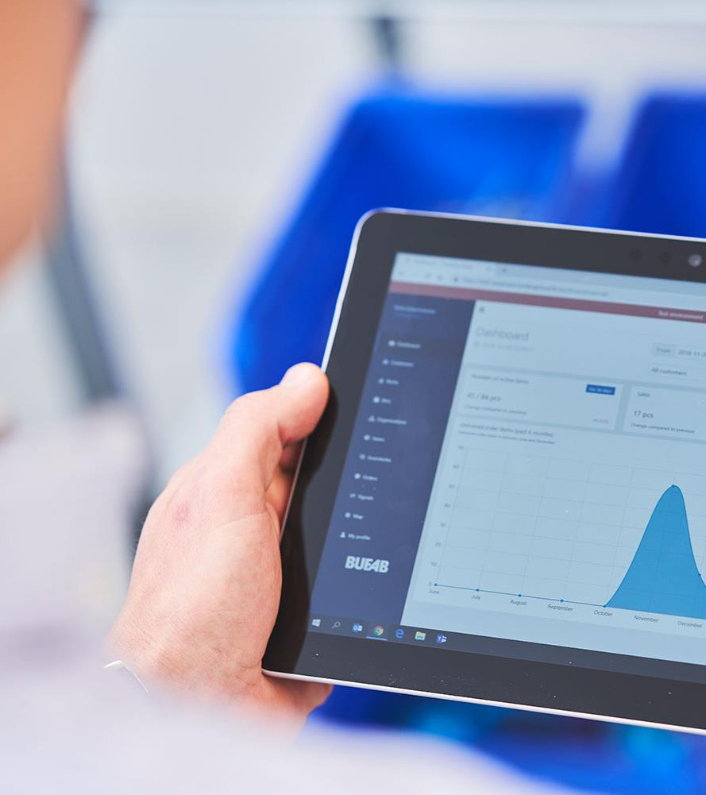
System software
All logistics solutions need to be supported by a central system that keeps track of inventory. You might think the logistics solutions need to communicate directly with your ERP system, but this is not the case - although it is necessary for some companies. Most importantly, the logistics solutions supplier must be open-minded and implement the best solution for you.
When setting up a Logistics solution, often called a vendor-managed inventory (VMI) solution, it is important to think long-term. Choose a supplier with software that can easily adapt to new and future solutions to ensure the logistics solution's long-term success and flexibility.
Benefits
Real-time updated information on stock levels with scale systems and the order situation for all solutions.
Accessible anywhere.
A quick overview gives Peace of Mind and allows you to place energy on other things.
Explore on bufab.com

Slide 19

Thanks!
Hopefully you've got a better idea of how logistics solutions could streamline your C-parts operation.
If you want to find out how they could be put into practice at your company, get in touch with us below – we'll be happy to guide you further.
Talk to an expert

